Slide 1

What is
Git & GitHub?
Icons made by Freepik from www.flaticon.com

Slide 2
Lessons' Objective
For everyone to…
1
Understand what is Git and GitHub
2
Successfully manage their code projects with Git and GitHub

Slide 3


Overview
What is Git?
What is GitHub?
Hands-On Sections
Install Git
Create GitHub account
Start a repository
GitHub Icon
GitHub Icon

Slide 4
What is Git?
What is Git?

Slide 5
First, What is Version Control?
What is Git?
History - Keeps track of all the changes made to the files over time
Teamwork - Allows for multiple people working on the same project at the same time
Backup - Allows for easy file and folder recovery
Game Checkpoint
Notes:
Similar to a game's checkpoint system.
You save your current status of the game so if you were to miss up in the next level,
you do not start all over but simply go back to where you last saved your spot.

Slide 6
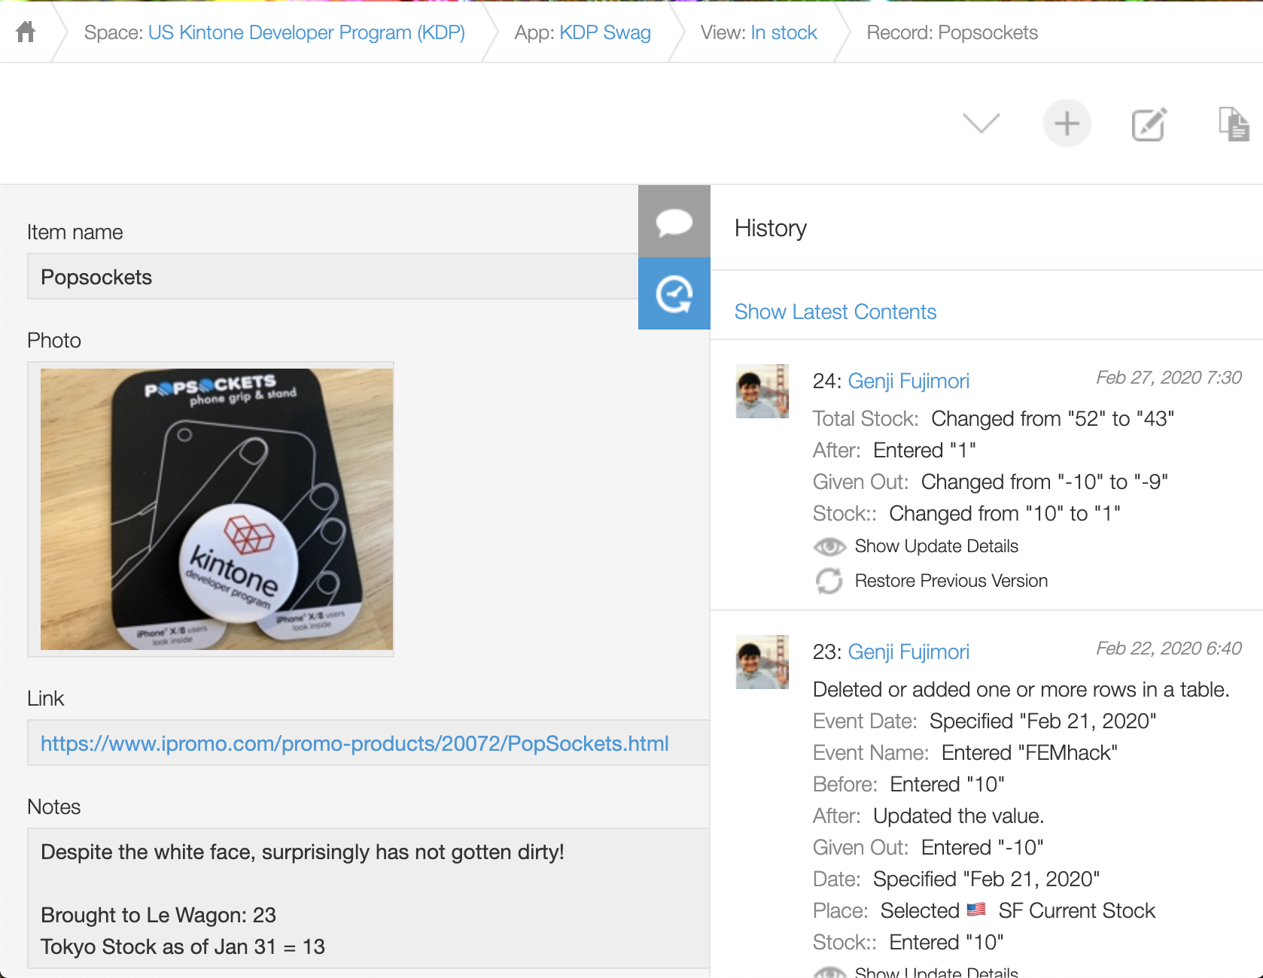
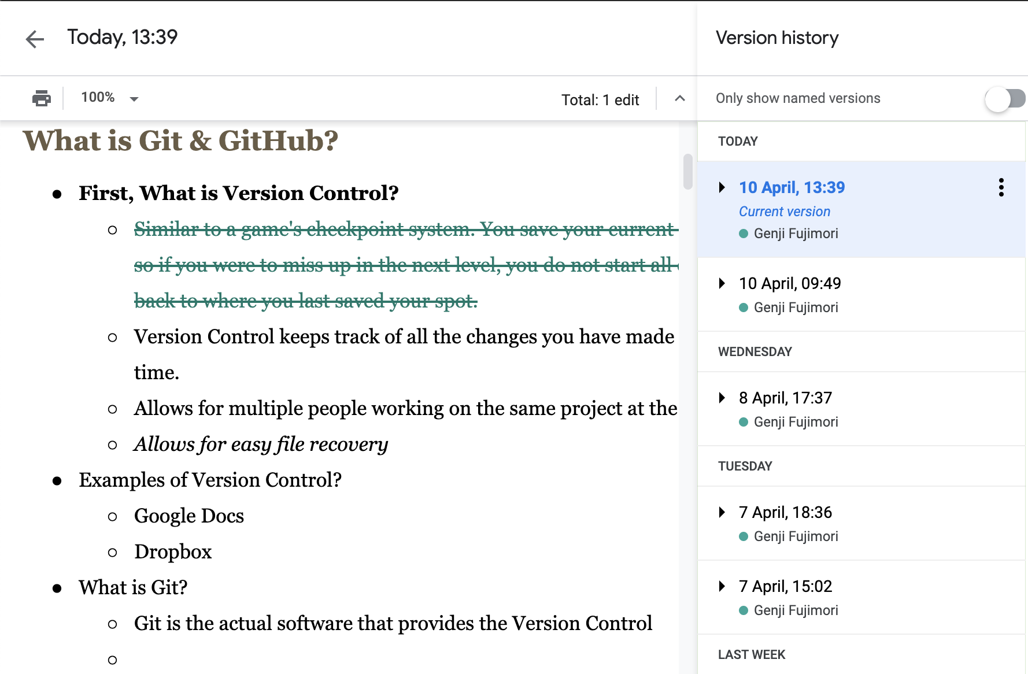
Version Control Examples
Git
Google Docs
Kintone
Notes:
Similar to a game's checkpoint system.
You save your current status of the game so if you were to miss up in the next level,
you do not start all over but simply go back to where you last saved your spot.

Slide 7
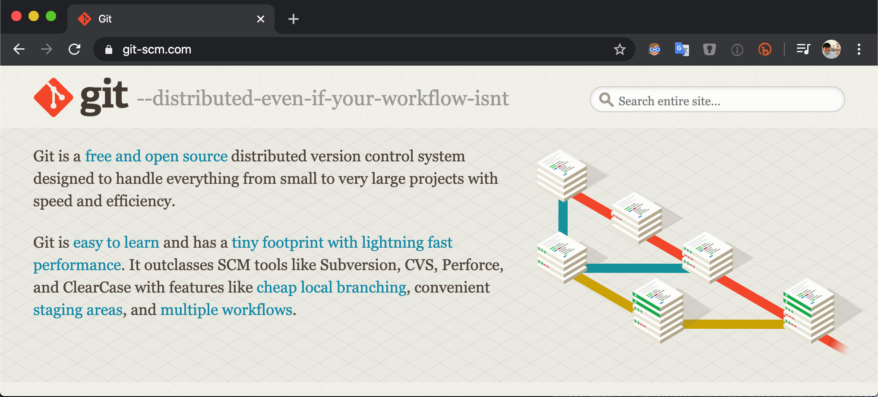
Git is…
Git
Git is the actual software that provides the version control to manage software development
Started in 2005 as a tool to manage Linux kernel development
Free & open-source distributed version control system

Slide 8
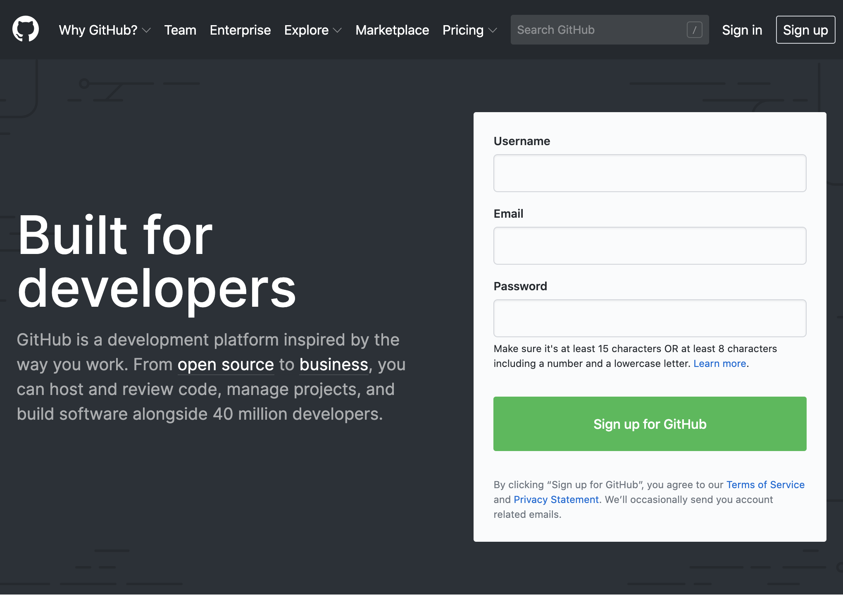
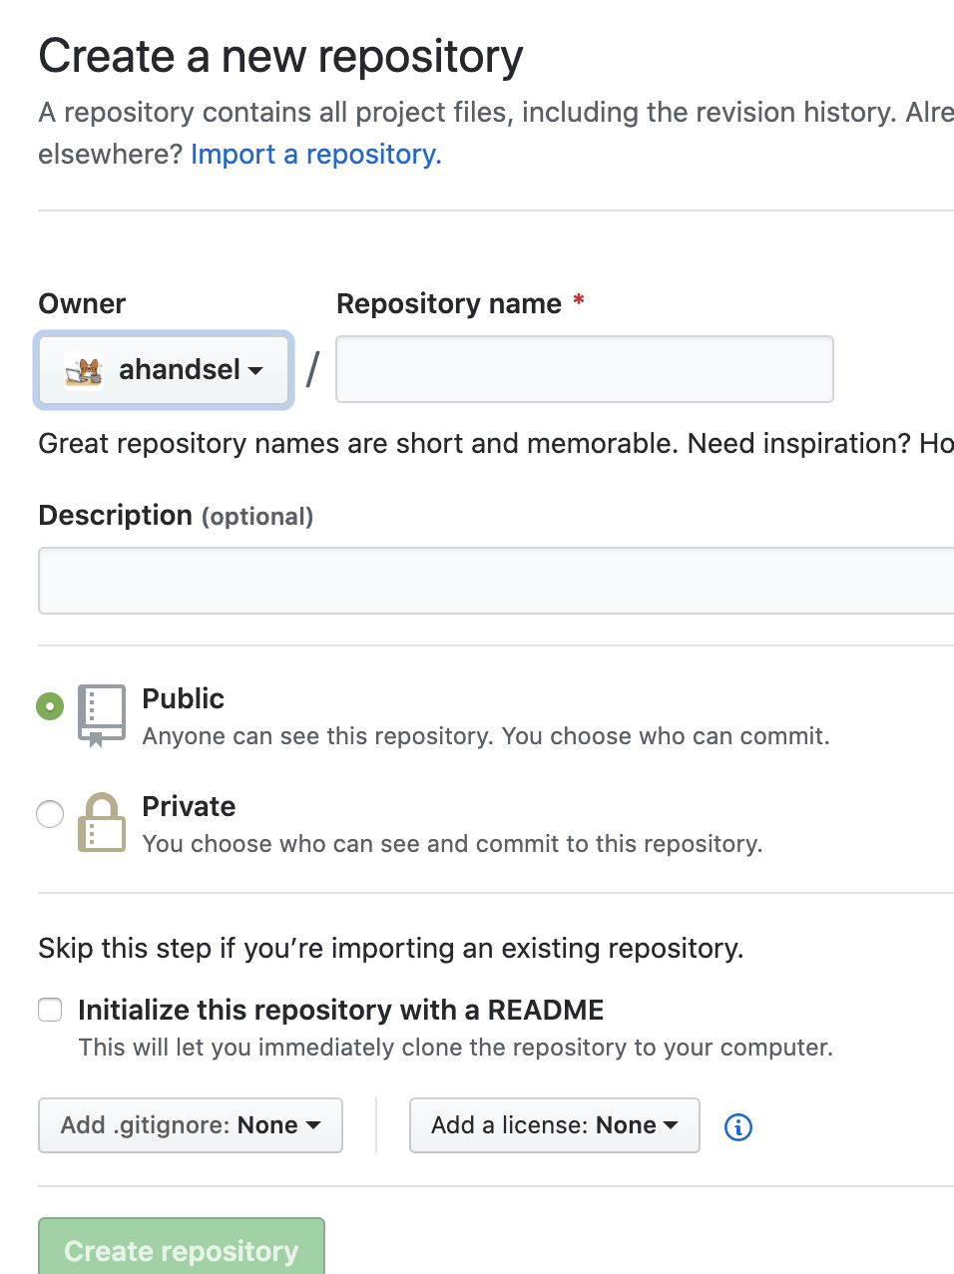
GitHub is…
GitHub
GitHub.com is a collaboration platform
Web-based git repository hosting service.
i.e. hosts the 'remote repositories'
Founded in 2008 and now a Microsoft subsidiary

Slide 9
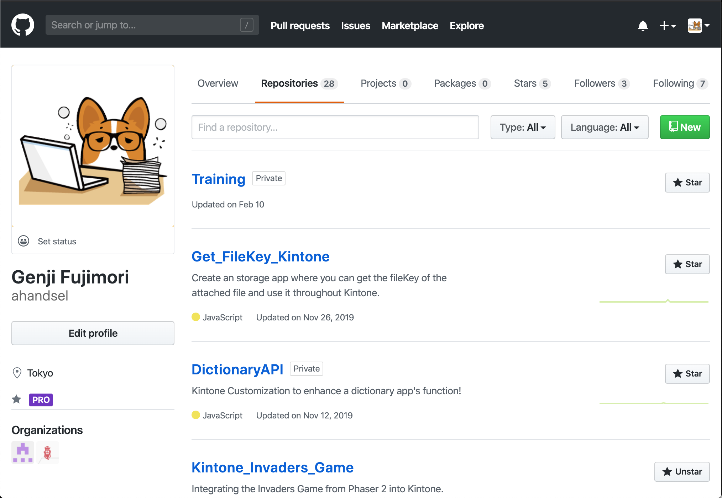
Create a GitHub Account
Installation
Create a GitHub account → github.com
Add 2-Factor Authentication (help doc)
Go to GitHub Settings:
Profile Photo > Settings > Security > Two-factor authentication
https://github.com/settings/security
Install an Authenticator App:
e.g. Microsoft, Authy, Enpass

Slide 10
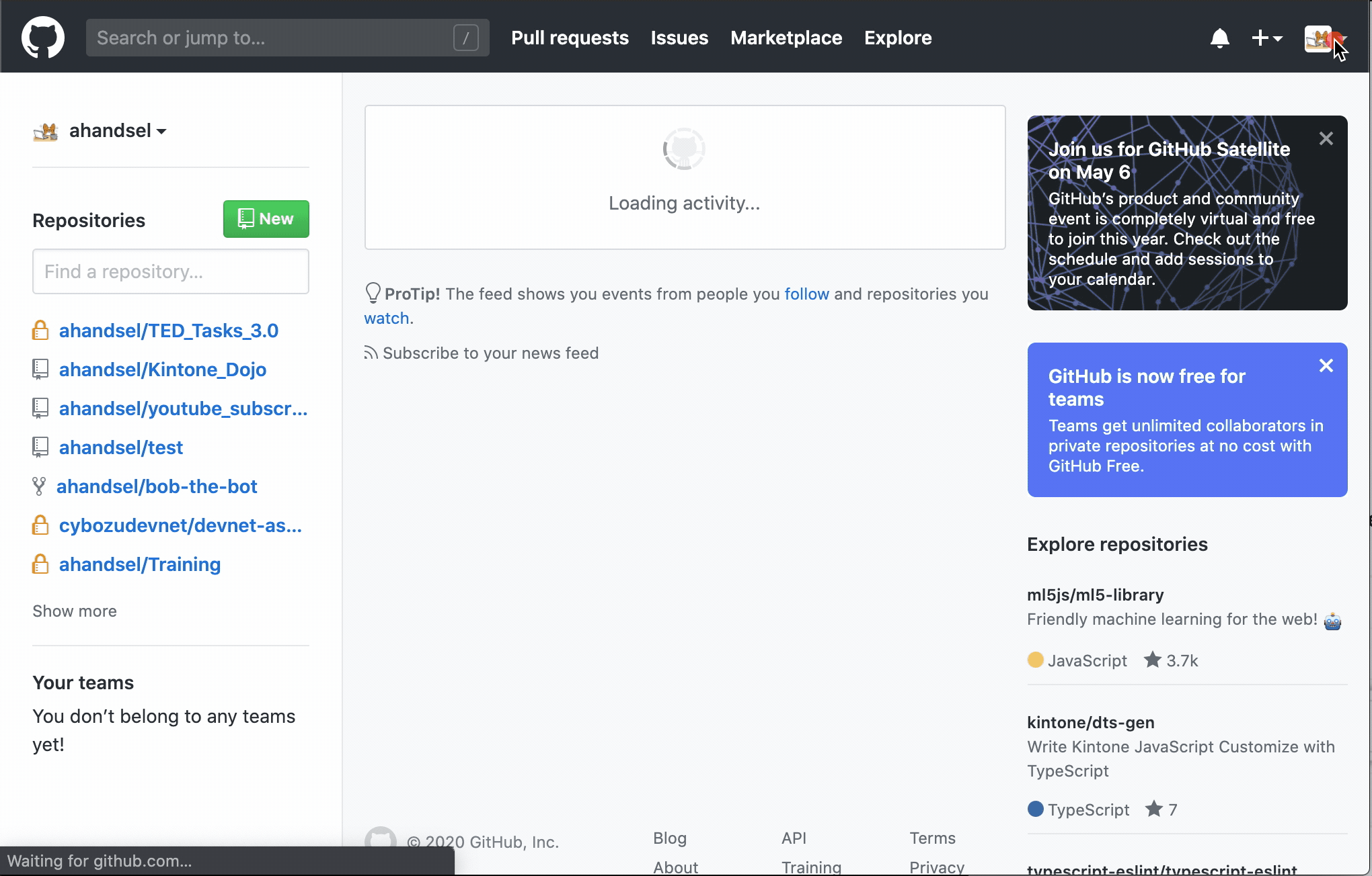
Personal Access Token for Command Line
Installation
Generate a Personal Access Tokens
Settings > Developer settings > Personal access tokens
https://github.com/settings/tokens/new
Use this token when accessing your GitHub account via Terminal
Use Tokens instead of passwords.
Generate a token per use-case.
https://help.github.com/en/github/authenticating-to-github/creating-a-personal-access-token-for-the-command-line
Notes:
https://help.github.com/en/github/authenticating-to-github/creating-a-personal-access-token-for-the-command-line

